Slide 1

Weather Conditions & Climate change with ClimateWins
An Interim Report by Dr Yasemin Mustafa
Presented on 23rd July 2025

Slide 2

Why Does It Matter?
Extreme weather is becoming more frequent and severe across Europe and the world.
ClimateWins, a European nonprofit, is exploring how machine learning can help predict and understand the impacts of climate change.
This project uses data science to support smarter, more adaptive responses to our changing environment.

Slide 3

Inside the Figures
Daily weather records from 18 stations across Europe
Sourced from the European Climate Assessment & Dataset (ECA&D)
Covers the period 1960–2022
Includes temperature, humidity, precipitation, snow, and more
Complete dataset with no missing values
Available as a downloadable .csv file

Slide 4

Not All Data is Created Equal
Temporal Bias: Older records (e.g. 1960s) may reflect outdated tools and methods
Historical Bias: Long-term data can mask recent climate shifts
Selection Bias: Stations are concentrated in developed areas—underrepresenting others

Slide 5



What Might We Discover?
1
2
3
Machine Learning can accurately predict daily weather conditions using historical climate data across Europe.
Prediction accuracy will differ by region, influenced by geographic and climatic variability.
No single algorithm will be universally superior – model performance will depend on local climate patterns and data structure.

Slide 6
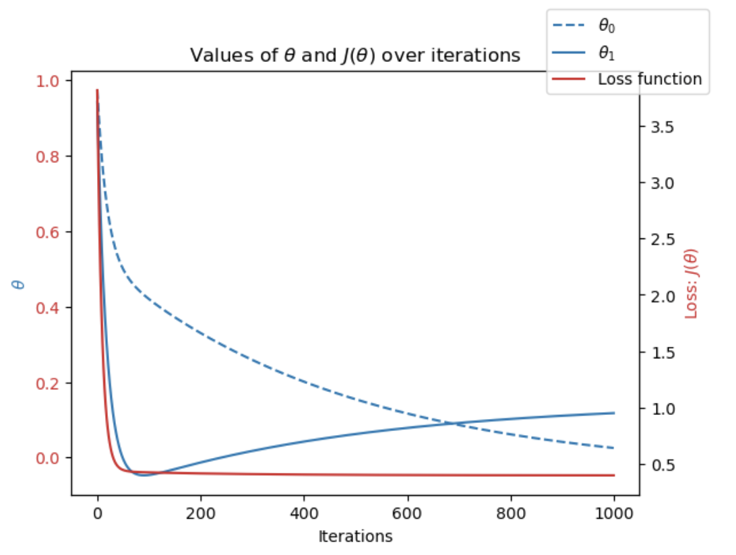
Fine-Tuning the Forecast
Gradient Descent was used to optimise the weather prediction model
This method adjusts parameters to minimise the loss function (i.e. the error in prediction)
Through iterative updates, the model learns to make more accurate predictions
Temperature data is highly suitable for predictive modelling using differentiable functions
Figure 1. Gradient descent loss function for Dusseldorf’s average daily temperatures in 2020.

Slide 7
Method 1: K-Nearest Neighbor (KNN)
Table 1. KNN Predictions for 15 different weather stations
Weather Station | Accurate Predictions |  | False Positive | False Negative | Accuracy (%)
Basel | 3907 | 935 | 431 | 465 | 85
Belgrade | 3238 | 1502 | 538 | 460 | 81
Budapest | 3416 | 1432 | 484 | 406 | 85
Deblit | 4346 | 732 | 291 | 369 | 85
Dusseldorf | 4167 | 800 | 340 | 431 | 87
Heathrow | 4161 | 754 | 409 | 414 | 86
Kassel | 4563 | 607 | 252 | 316 | 90
Ljubljana | 3726 | 1133 | 469 | 410 | 85
Maastricht | 4249 | 819 | 313 | 357 | 88
Madrid | 2735 | 2257 | 433 | 313 | 87
Munchenb | 4222 | 766 | 324 | 426 | 87
Oslo | 4624 | 507 | 255 | 352 | 89
Sonnblick | 5738 | 0 | 0 | 0 | 100
Stockholm | 4449 | 588 | 317 | 384 | 88
Valentia | 5391 | 108 | 71 | 168 | 96
Average |  |  |  |  | 88
KNN predicts weather by comparing each new data point to its closest neighbors
The model groups similar data points, using a k-value of 3
Applied to 15 European weather stations, it predicted pleasant weather days with up to 88% accuracy
KNN works well but can overfit, especially in stations with extreme or limited weather patterns

Slide 8
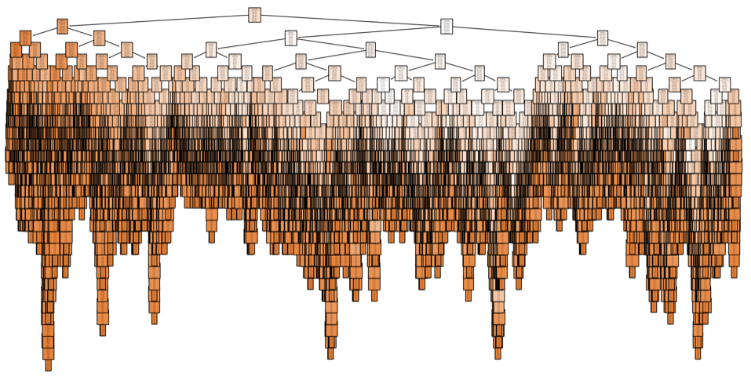
Method 2: Decision Tree
Make predictions by asking a series of yes/no questions
The algorithm splits data into branches until it reaches a final classification (leaf)
Accuracy: ~85% (training and testing)
The model became too complex, with many branches causing overfitting and long training times
To improve performance, the tree likely needs to be pruned
Figure 2. Decision tree used on 15 European weather stations to predict pleasant weather days.

Slide 9
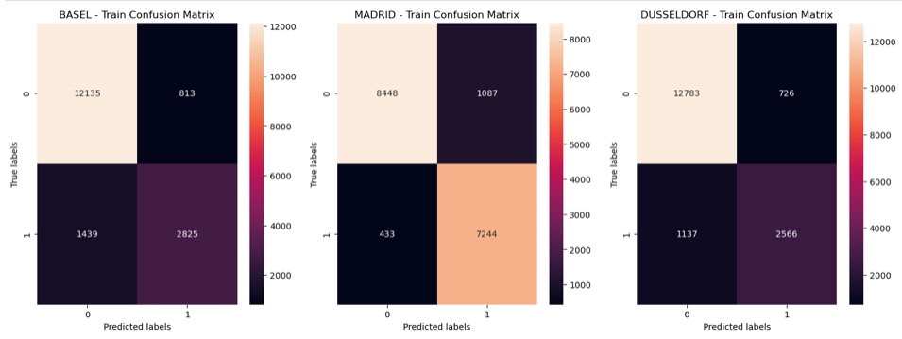
Method 3: Artificial Neural Network (AANs)
Mimics how the human brain learns
Uses layers of “neurons” to find patterns in data
Predicts pleasant weather based on past conditions
Tested on 3 European stations
Accuracy: 89% (training), 87% (testing)
Tweaked layer size and iterations during training
Overfitting likely—model performed better on training than testing data
Figure 3. Confusion matrices showing accurate (top-left, bottom-right) and inaccurate (top-right, bottom-left) predictions for pleasant and unpleasant days, respectively.

Slide 10

Which Algorithm Performs Best?
KNN shows the highest overall accuracy of 88%
Decision Tree performs well (~85%) but is more complex and less generalisable
ANN excels at some stations (e.g. Madrid 91%) but shows signs of mild overfitting
Sonnblick’s perfect scores across models may suggest data imbalance
Overall, KNN is the most consistent and reliable model for ClimateWins
ANN may still be valuable where nonlinear patterns are stronger

Slide 11
Summary
Machine learning can predict daily weather conditions in Europe accurately, with some models reaching up to 88% accuracy.
Prediction accuracy varies by location, influenced by regional climate patterns.
Over time, machine learning models can help detect signs of climate change by tracking increases in unpleasant weather events.

Slide 12

Next Steps
Explore unsupervised machine learning to uncover hidden patterns
Expand data inputs (e.g. wind speed, snow) for deeper analysis
Continue tuning model parameters to improve accuracy and reduce overfitting
Include additional weather stations to boost regional diversity and generalisability
Begin tracking long-term weather trends for early signs of climate change

Slide 13



Thank You
I appreciate your time and interest in this project.
If you'd like to explore the code, data, and visualisations further, please check out my GitHub:
👉 https://github.com/YLMustafa/climate_wins
Feel free to reach out with any questions or feedback!

